Slide 1
Introduction to Supervised Machine Learning

Slide 2
Learning Goals
In this section, we will discuss:
- Types of Supervised Learning
- Examples of Regression and Classification Problems

Slide 3
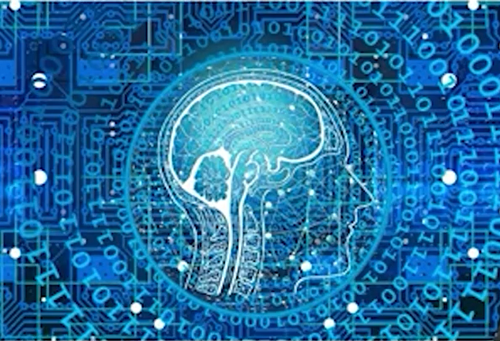
What Is Machine Learning?
Machine learning: is the process through which computers are said to "learn" and infer predictions from data.

Slide 4
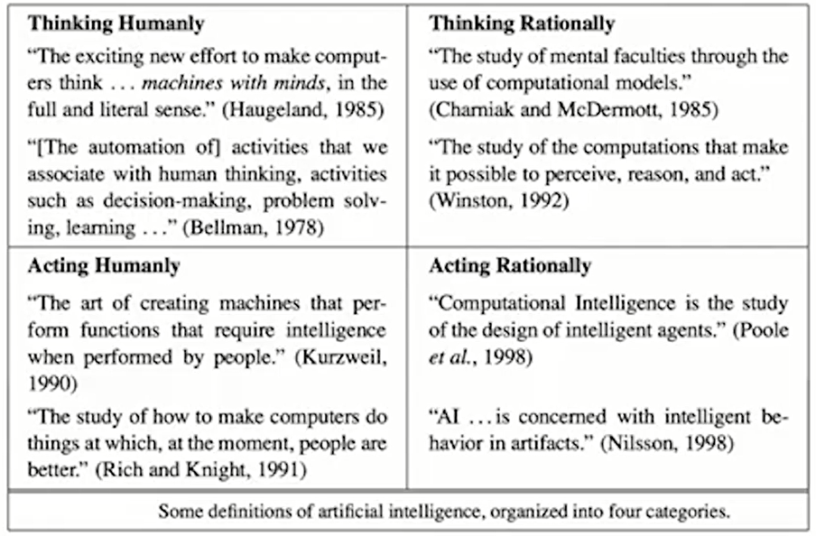
Machine Learning in Context: AI

Slide 5
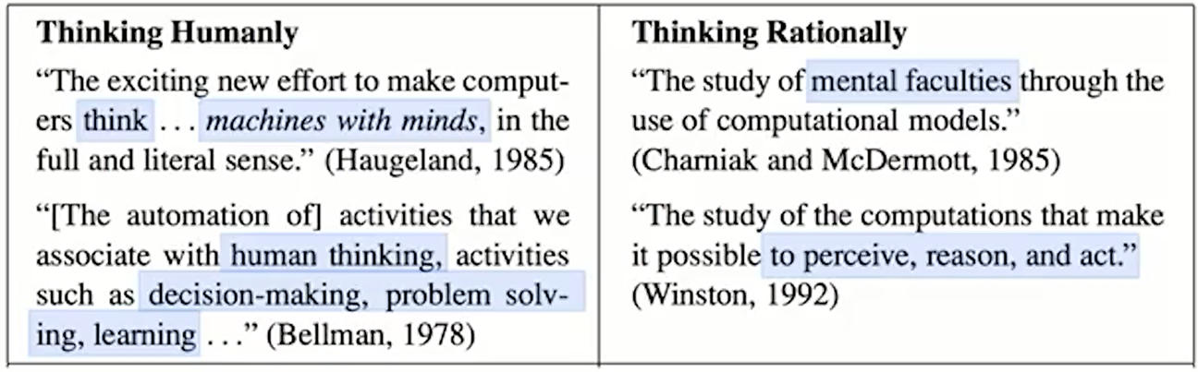
Machine Learning in Context: AI

Slide 6
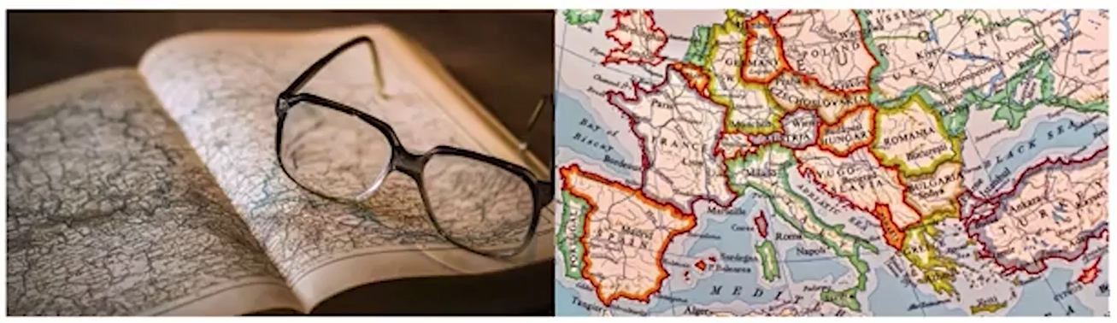
Model: A Learning Algorithm
A model is a small thing that captures a larger thing.
A good model omits unimportant details while retaining what's important.

Slide 7
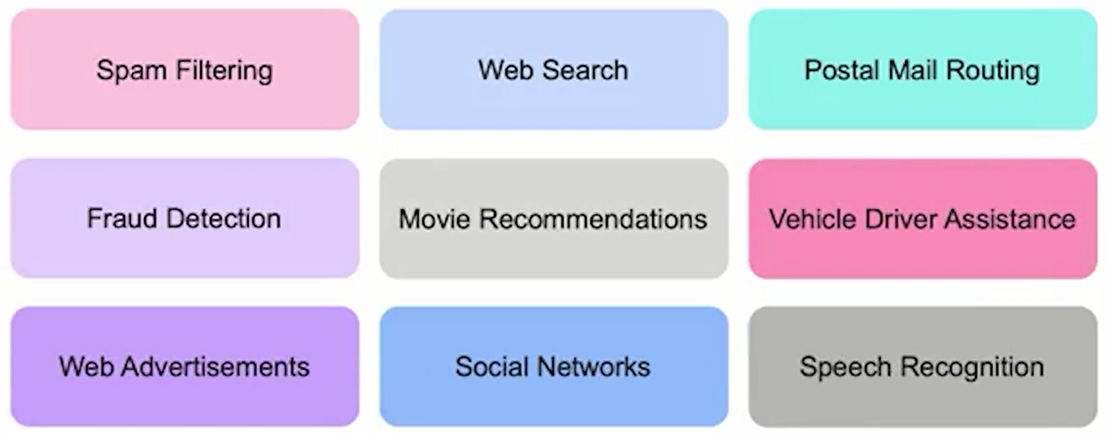
Machine Learning in Our Daily Lives

Slide 8
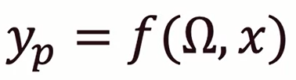
Fit Parameters vs. Hyperparameters
ML Framework (applies to Supervised Machine Learning Models):
Our framework estimates a relationship between the features and target:
- Here, 𝛀 (the Fit Parameters) involve aspects of the model we estimate (fit) using the data.
– To implement our approach, we make decisions regarding how to produce these estimates.
- These decisions lead to hyperparameters, that are an important part of the machine learning workflow (though not explicit components of the model).

Slide 9
Machine Learning Framework
ML Framework (applies to Supervised Machine Learning Models):
Two main modeling approaches:
- Regression: y is numeric.
E.g.: stock price, box office revenue, location (x,y coordinates).
- Classification: y is categorical.
E.g.: face recognition customer churn, which word comes next.

Slide 10
How Does Machine Learning Work?
ML Framework (applies to Supervised Machine Learning Models):
x: Input.
y_{p}: Output (values predicted by the model).
f(.): Prediction function that generates predictions from x and 𝛀.

Slide 11
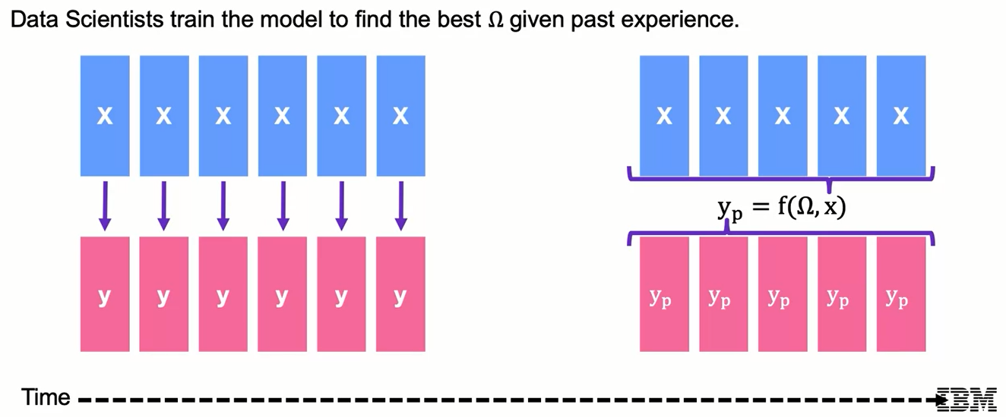
Machine Learning Framework

Slide 12
How Does Machine Learning Work?
ML Framework (applies to Supervised Machine Learning Models):
x: Input.
y_{p}: Output (values predicted by the model).
f(.): Prediction function that generates predictions from x and 𝛀.
J(y, y_{p}): Loss
- Most ML models define a quantitative score for how "good" our predictions are.
- Typically measures how close our predictions are to the true values.

Slide 13
How Does Machine Learning Work?
ML Framework (applies to Supervised Machine Learning Models):
x: Input.
y_{p}: Output (values predicted by the model).
f(.): Prediction function that generates predictions from x and 𝛀.
J(y, y_{p}): Loss
Update rule: using features x and outcome y, choose parameters 𝛀 to minimize loss J

Slide 14
Supervised Machine Learning Learning Goals
In this section, we will cover:
- Machine Learning Objectives: interpretation and prediction
- Examples of Machine Learning applications
\
- The Machine Learning Framework

Slide 15
Interpretation and Prediction
Interpretation:
- In some cases, the primary objective is to train a model to find insights from the data.
- In Y_{p} = f(𝝮, x), the interpretation approach uses 𝝮 to give us insight into a system.
- Common workflow:
• Gather x,y; Train model by finding the 𝝮 that gives the best prediction Y_{p} = f(𝝮, x).
• Focus on 𝝮 (rather than Y_{p}) to generate insights.
- Example interpretation exercises:
• x = customer demographics, y = sales data; examine 𝝮 to understand loyalty by segment
• x = car safety features, y = traffic accidents; examine 𝝮 to understand what makes cars safer
• x = marketing budget, y = movie revenue; examine 𝝮 to understand marketing effectiveness

Slide 16
Interpretation and Prediction
Prediction:
- In some cases, the primary objective is to make the best prediction.
- In Y_{p} = f(𝝮, x), the prediction approach compares Y_{p} with y.
- The focus is on performance metrics, which measure the quality of the model's predictions.
• Performance metrics usually involve some measure of closeness between Y_{p} with y.
• Without focusing on interpretability, we risk having a Black-box model.
- Example prediction exercises:
• x = customer purchase history , y = customer churn; focus on predicting customer churn
• x = financial information, y = flagged default/non-default; focus on predicting loan default
• x = purchase history, y = next purchase; focus on predicting the next purchase

Slide 17
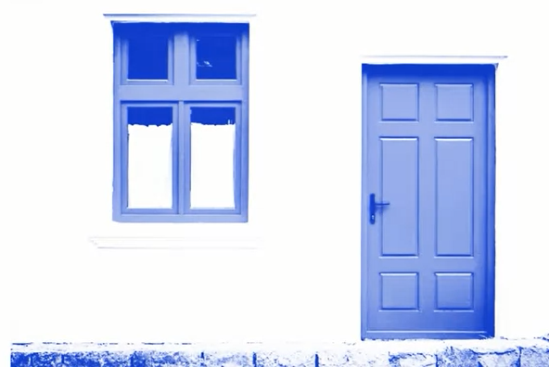
Example: Regression with Housing Data
In this course, we will examine housing datasets.
Here, our target is the price of housing, and our features include characteristics about the house and area.
Suppose we fit our model Y_{p} = f(𝝮, x), based on data on housing sales in Ames, Iowa, and obtain estimates of parameters 𝝮.
These parameters represent coefficients relating the features x with expected target values.
We can interpret our results to learn about feature importance.

Slide 18
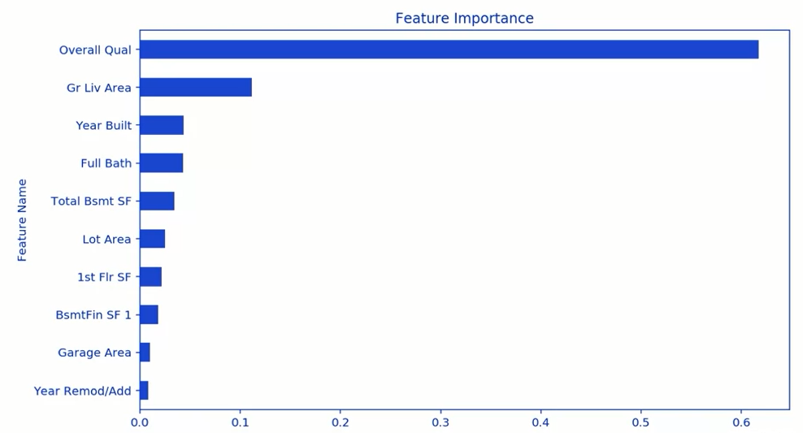
Housing Data: Regression Interpretation
Regression Interpretation:
Examining results from regression of housing sale prices in Ames, lowa.
Which features are most important?

Slide 19
Example: Regression with Housing Data
Here, our target is the price of housing, and our features include characteristics about the house and area.
Suppose we fit our model Y_{p} = f(𝝮, x), based on data on housing sales in Ames, Iowa, and obtain estimates of parameters 𝝮.
Our primary aim may be prediction, in which case we are more focused on generating values for Y_{p} than in interpreting parameters.

Slide 20
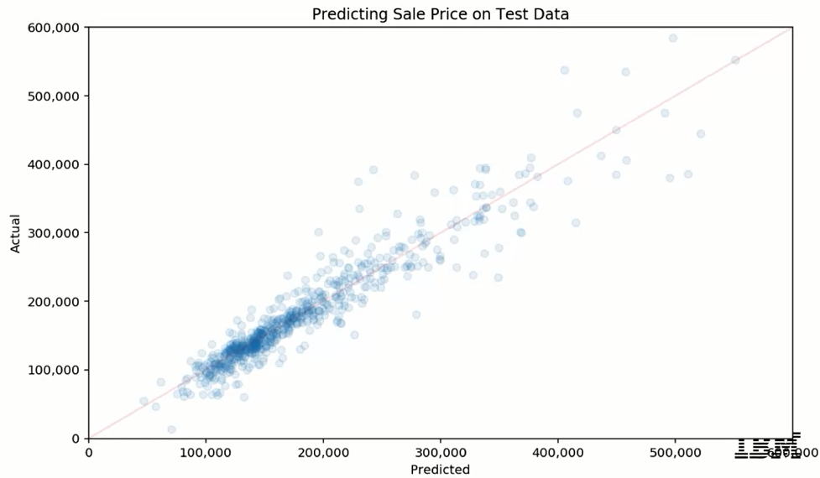
Housing Data: Regression Prediction
Prediction using Regression Example:
Use characteristics to predict unknown sale prices, focusing on how accurately we are able to predict.

Slide 21
Classification Example: Customer Churn
Customer churn occurs when a customer leaves a company.
Data related to churn may include a target variable for whether or not the customer left, as well as information on customer characteristics.
Here, we may be interested in both:
- Interpretation: understanding factors that may lead to customers leaving.
- Prediction: estimating how long customers are likely to stay can help us understand
how many we still need to support, and how valuable they are to the company.

Slide 22
Two Common Approaches
Interpretation and prediction in Supervised Machine Learning
- Majority of projects will call for a balance.
- Interpretation can provide insight into improvements in prediction, and
vice-versa.
- Not all models will allow both: Supervised Machine Learning models
provide varying levels of support for interpretation vs. prediction

Slide 23
ML Framework: Takeaways
Machine Learning is the subset of Al that focuses on model building to support a goal of interpretation and/or prediction.
ML algorithms;
- Use past experience to build a model that is useful for future experience.
- Follow a general form: Y_{p} = f(𝝮, x).

Slide 24
Learning Recap
In this section, we discussed:
- Machine Learning Objectives: interpretation and prediction
- Examples of Machine Learning applications
\
- The Machine Learning Framework

Slide 25
Regression and Classification Examples

Slide 26
Learning Goals
In this section, we will cover:
- Types of Supervised Learning
- Examples of Regression and Classification Problems

Slide 27
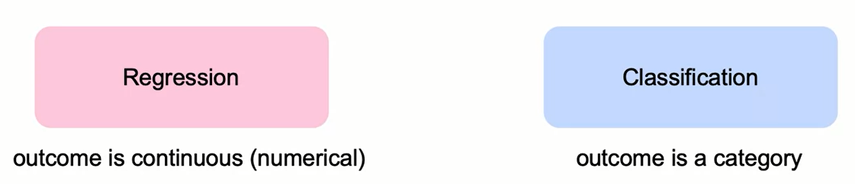
Types of Supervised Learning

Slide 28
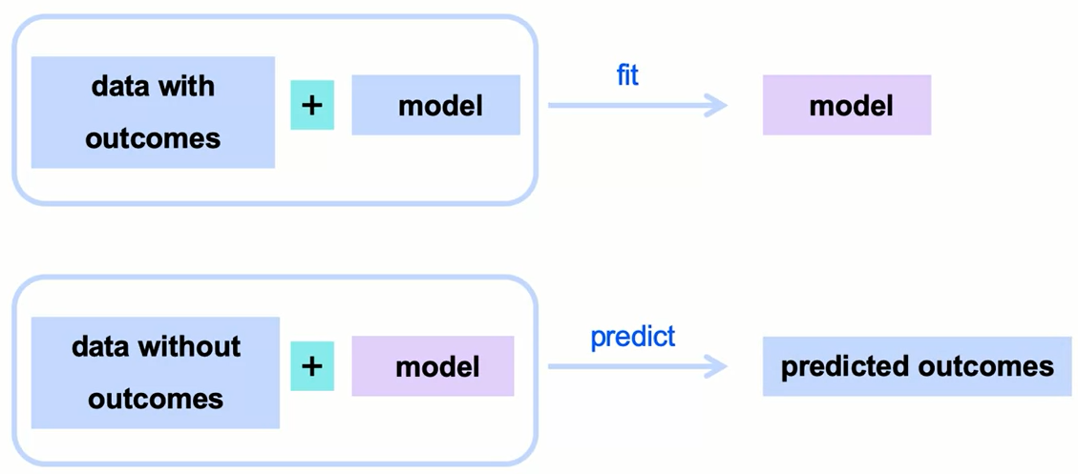
Supervised Learning Overview

Slide 29
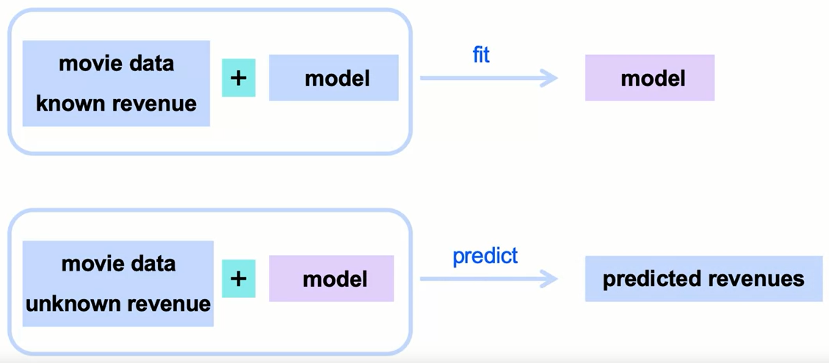
Numeric Predicting: Movie Revenue

Slide 30
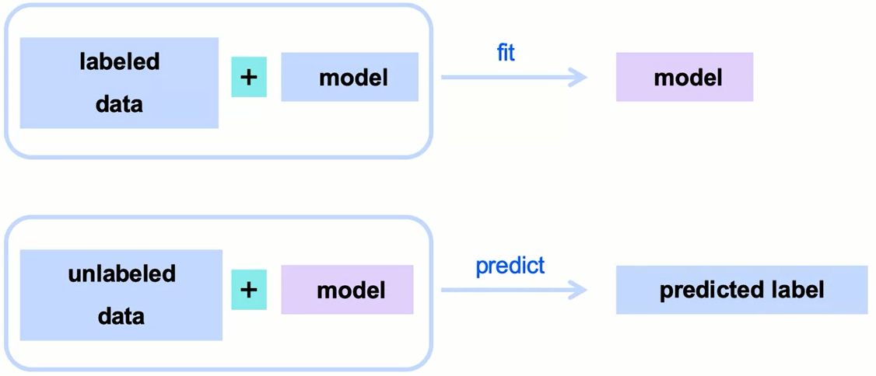
Classification: Categorical Answers

Slide 31
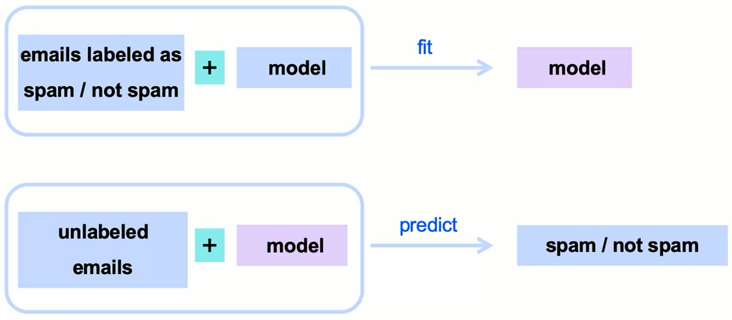
Classification: Predicting Spam Emails

Slide 32
What is Needed for Classification?
Model data with:
- Features that can be quantified
- Labels that are known
- Method to measure similarity

Slide 33
Summary
Introduction to Supervised Machine Learning
The types of supervised Machine Learning are:
Regression, in which the target variable is continuous
Classification, in which the target variable is categorical
To build a classification model you need:
Features that can be quantified
A labeled target or outcome variable
Method to measure similarity

Slide 34
Learning Recap
In this section, we discussed:
- Types of Supervised Learning
- Examples of Regression and Classification Problems

